Slide 1
ONT-Analysis Discussion Methylation Study
Xin Li
09/25/2025

Slide 2
Outline
General Methylation Analysis
DMR (Differentially Methylated Region) Analysis
Notice
All examples in this presentation are based on the running results of SD386613

Slide 3
General Methylation Analysis

Slide 4
Data
Public Dataset (question…)
https://github.com/NCI-CGR/ONT_Analysis_Xin_Share_Pubic/tree/main/Analysis/Methylation/Dataset
modBAMs
MM/ML tags
MM:Z — Modified-base map. Tells you which canonical base (A/C/G/T) has which modification at which positions on the read.
ML:B:C — Modified-base likelihoods. A byte array (0–255) of per-site probabilities, 1:1 and in the same order as sites listed by MM.
Approx. probability: p ≈ value / 255.
How we obtain modBAMs
ONT Dorado
Megalodon
Unify the old style Mn/Ml to MM/ML
modkit update-tags

Slide 5
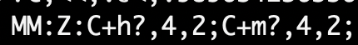
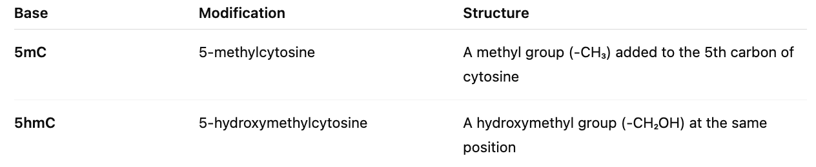
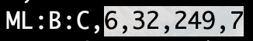
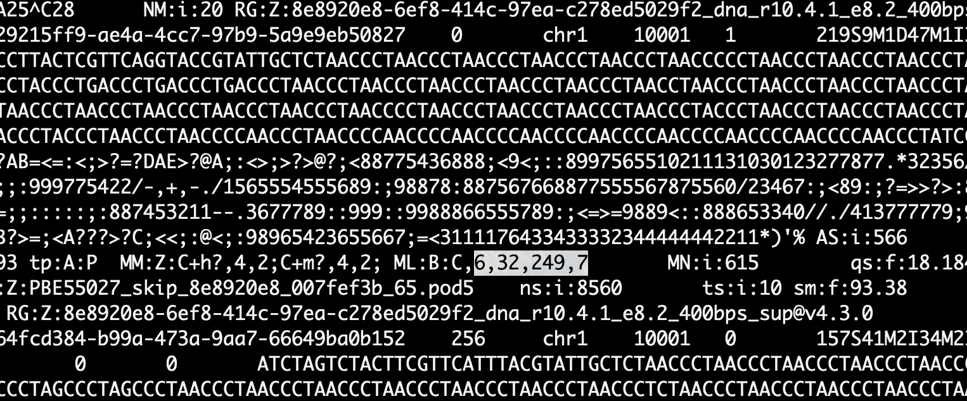
Data (Example)
: two modification entries, both on C:
C+h?,4,2 → 5hmC (h), strand unknown (?), deltas 4,2
C+m?,4,2 → 5mC (m), strand unknown (?), deltas 4,2
Delta rule (each entry counts from the start of the read, by Cs):
4,2 = skip 4 Cs, mark the 5th C; then skip 2 Cs, mark the 8th C.
Because both entries have the same deltas, both 5hmC and 5mC point to the 5th and 8th C on this read.
: ML probabilities (0–255 ≈ 0.0–1.0):
For 5hmC (two sites): 6/255 ≈ 2.4%, 32/255 ≈ 12.5% → very low.
For 5mC (two sites): 249/255 ≈ 97.6%, 7/255 ≈ 2.7% → the 5th C is very likely 5mC; the 8th C is unlikely modified.

Slide 6
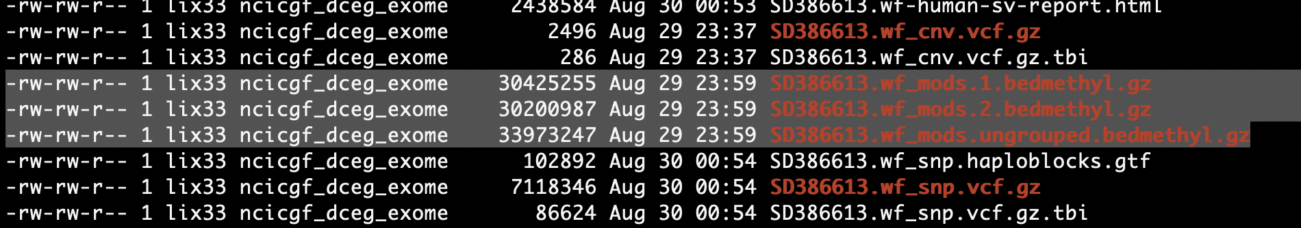
Tools and Pipeline
How to generate the methylation bed file (bedmethyl)
Pipeline
wf-human-variant pipeline
https://github.com/epi2me-labs/wf-human-variation
ont-methylDMR-kit
https://github.com/NyagaM/ont-methylDMR-kit/tree/master
Tool
Modkit
https://github.com/nanoporetech/modkit
Warning message (CRAM): detected non-BAM input format, please consider using BAM, CRAM may be unstable

Slide 7
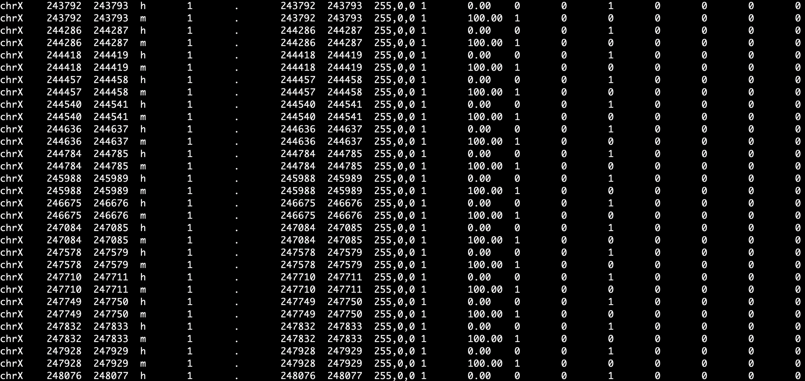
Results (Bedmethyl) Overview
Details
https://github.com/NCI-CGR/ONT_Analysis_Xin_Share_Pubic/blob/main/Analysis/Methylation/CustomizedScript/General_Note.md#Bedmethyl_Overview

Slide 8
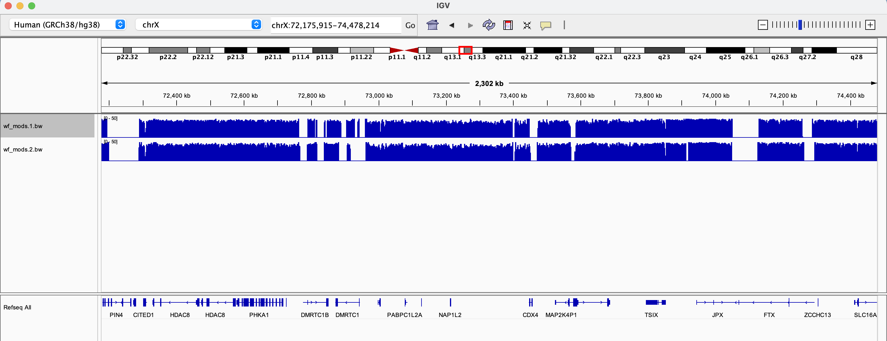
Visualization
IGV
Convert bedMethyl to .bigWig
Use the tools and dependences released by UCSC
Tools for summarizing the bigwig info (bigWigInfo)
https://github.com/NCI-CGR/ONT_Analysis_Xin_Share_Pubic/blob/main/Analysis/Methylation/CustomizedScript/convert_bed_to_bigwig.md

Slide 9
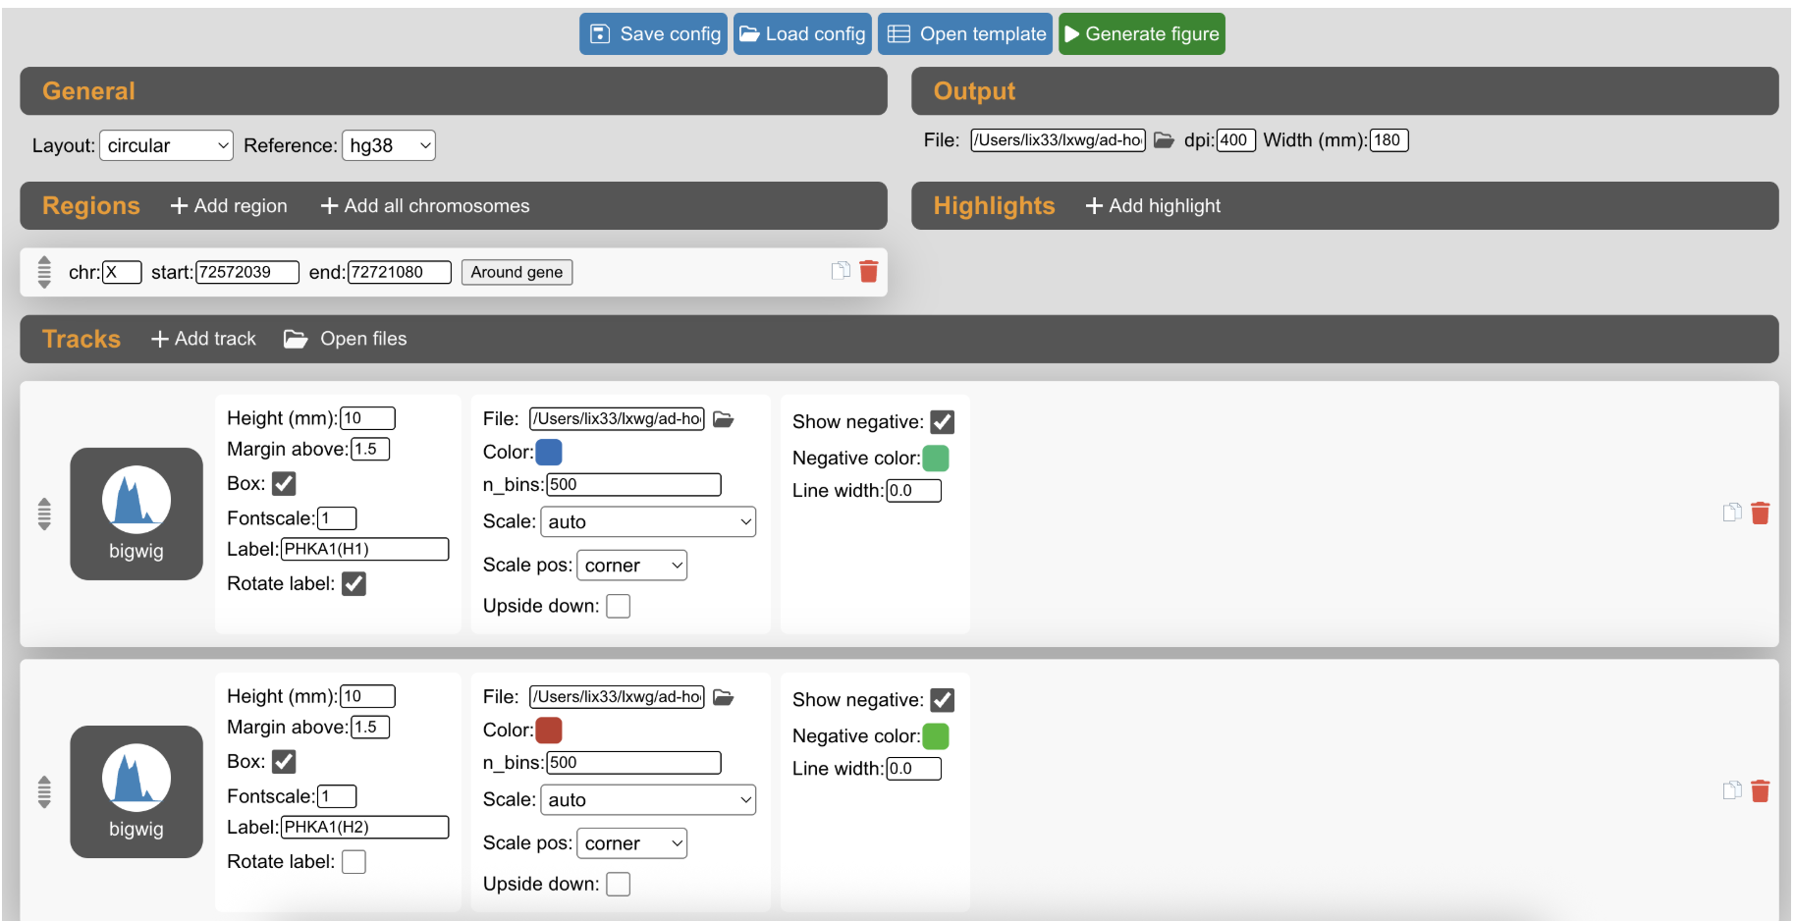
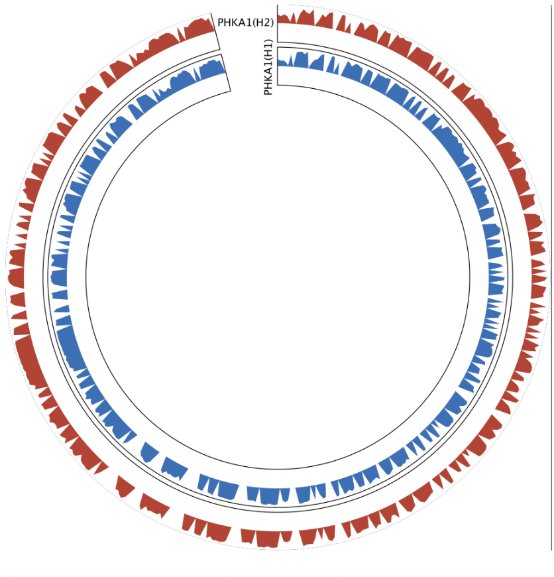
Visualization
Figure Illumination
Tool: Figeno (GUI)
https://github.com/NCI-CGR/ONT_Analysis_Xin_Share_Pubic/blob/main/Analysis/Methylation/CustomizedScript/convert_bed_to_bigwig.md

Slide 10
DMR (Differentially Methylated Region) Analysis

Slide 11
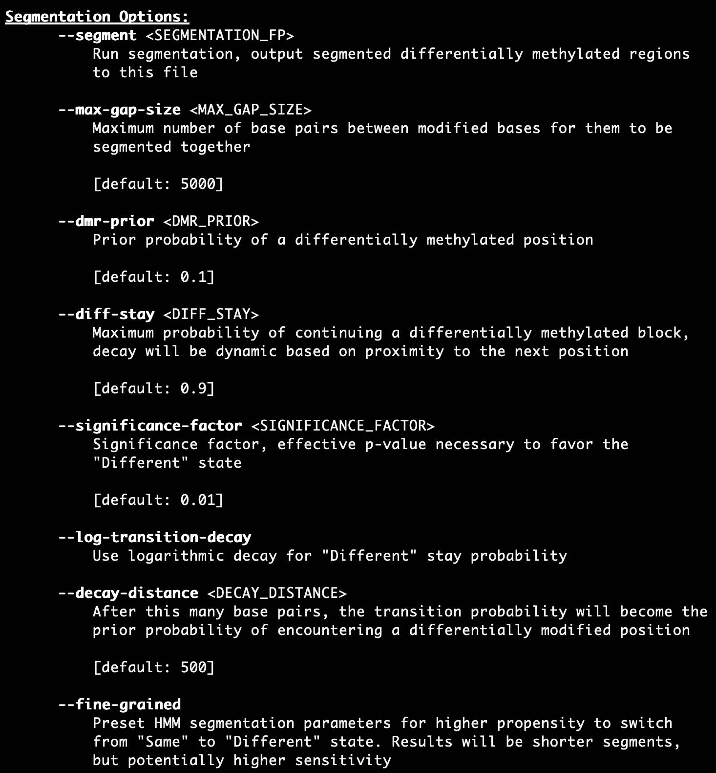
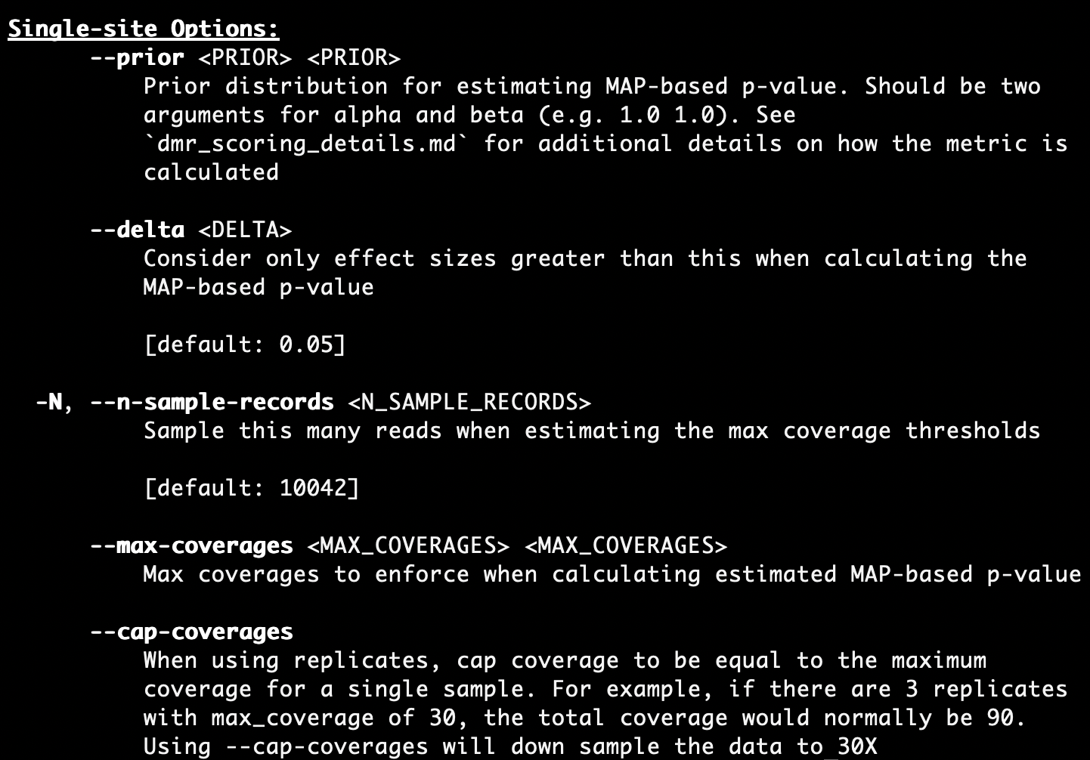
DMR Analysis
Three different types of analysis
Haplotype-specific DMR analysis (pair)
DMRs between two samples (pair)
DMRs from group analysis (multi)
Parameters used to define the DMR region (use the arguments from modkit as an example)

Slide 12
Tools and Pipeline
How to generate DMR bed file
Pipeline
ont-methylDMR-kit
https://github.com/NyagaM/ont-methylDMR-kit/tree/master
Tool
Modkit
https://github.com/nanoporetech/modkit
https://github.com/nanoporetech/modkit/tree/master/docs (HTML)
DSS
https://bioconductor.org/packages/release/bioc/vignettes/DSS/inst/doc/DSS.html

Slide 13
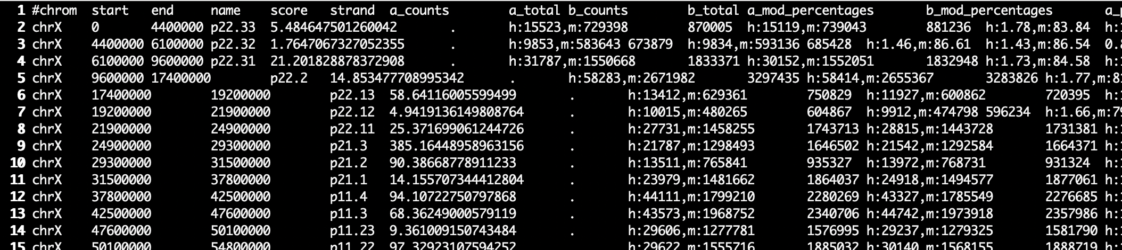
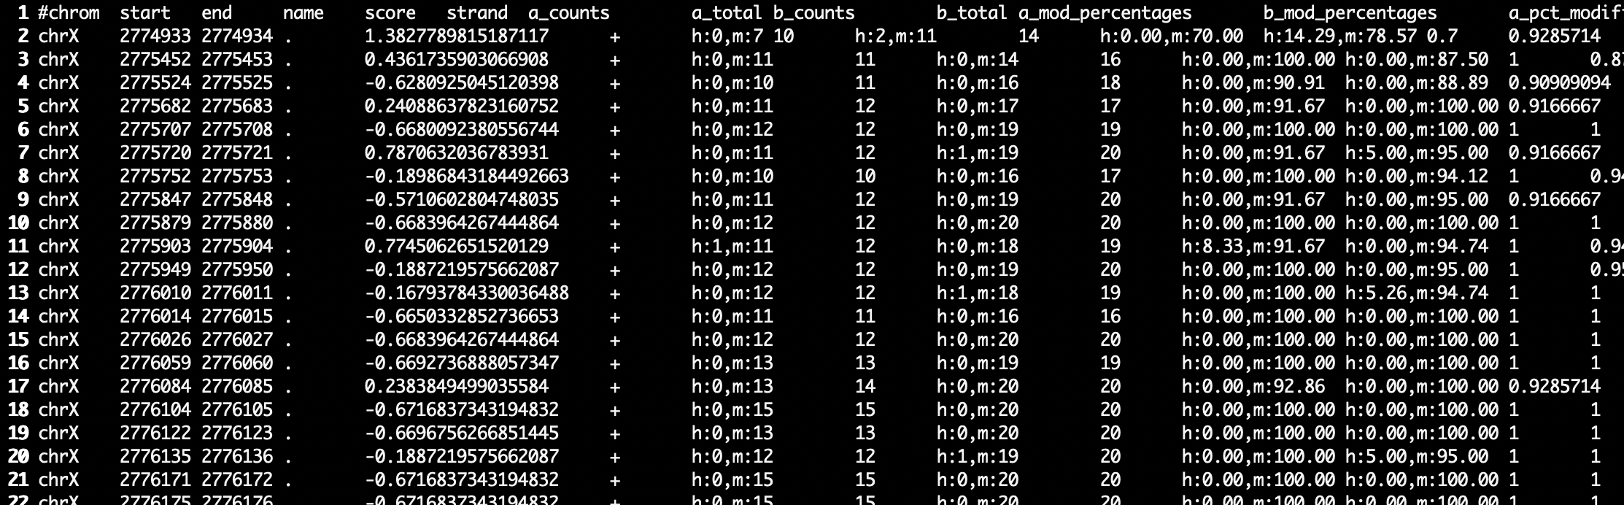
Results (dmr_regions) Overview
Predefined Bed file-based VS Denovo-based
https://github.com/NCI-CGR/ONT_Analysis_Xin_Share_Pubic/blob/main/Analysis/Methylation/CustomizedScript/General_Note.md#DMR_BED_Overview

Slide 14
Visualization
Tools and pipeline
Pipeline
ont-methylDMR-kit
Tools
modbamtools https://github.com/rrazaghi/modbamtools
methylartist https://github.com/adamewing/methylartist
Plot & Annotation (annotated features (GTF File))
All significant DMRs
significant DMRs for the provided genes
plot significant DMRs overlapping imprinted genes.
How to defined ”significant” and DMR plot regions (DSS as an example)
Methyl positions with less than 5 reads are filtered by default.
delta (threshold for defining DMR) at 10%
p-values threshold for calling DMR at 0.01
minimum length (in basepairs) required for DMR methylation change analysis at 100
minimum number of CpG sites required for DMR at 10
merging two DMRs that are very close to each other at less than 100 basepairs.

Slide 15
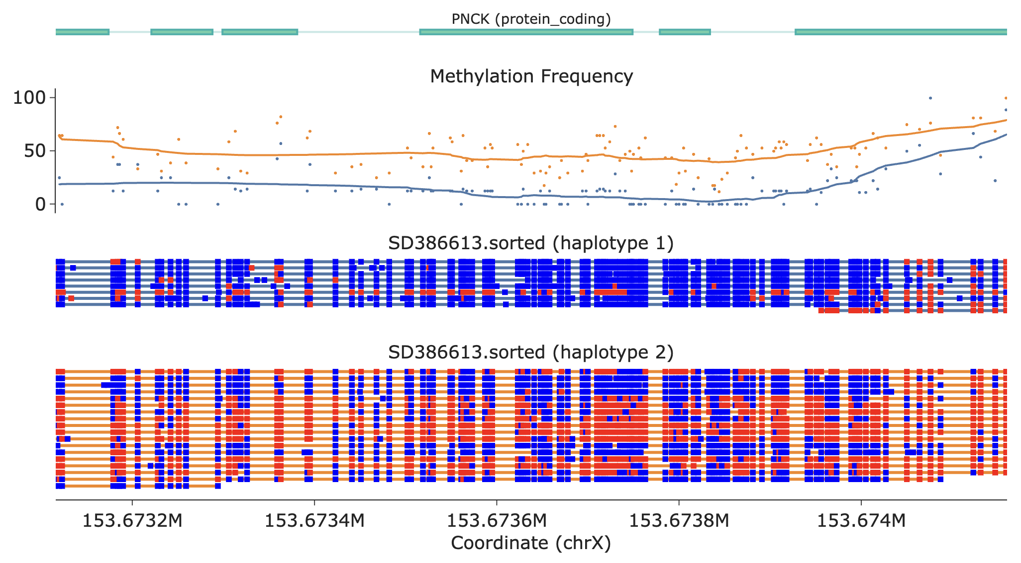
modbamtools
chrX_153673116-153674160_PNCK.html. (annotated)
Orange Line: haplotype 2; Blue Line: haplotype 1
Read Dot: methylation; Blue Dot: normal

Slide 16
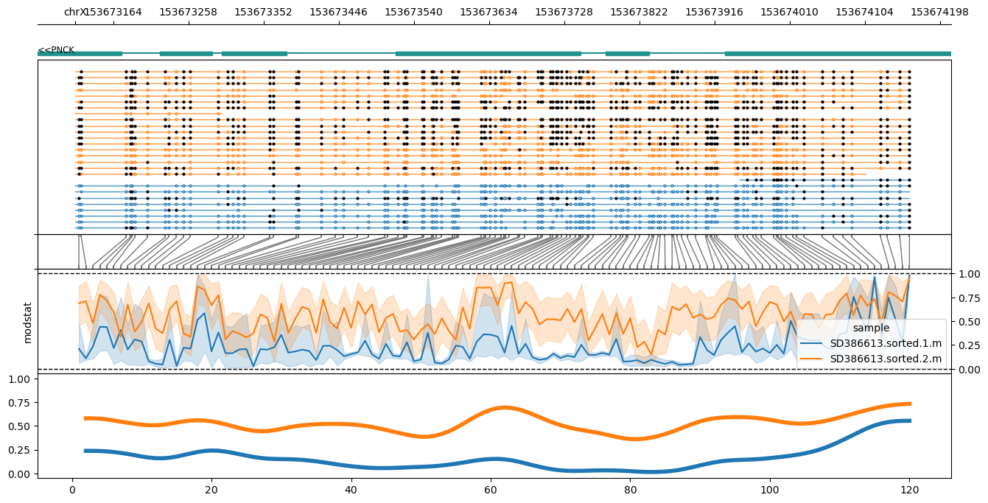
methylartist
chrX_153673116-153674160_PNCK.png
Same DMR as previous example (modbamtools)
Different ways to draw the plot
Pay attention to the “second section”

Slide 17
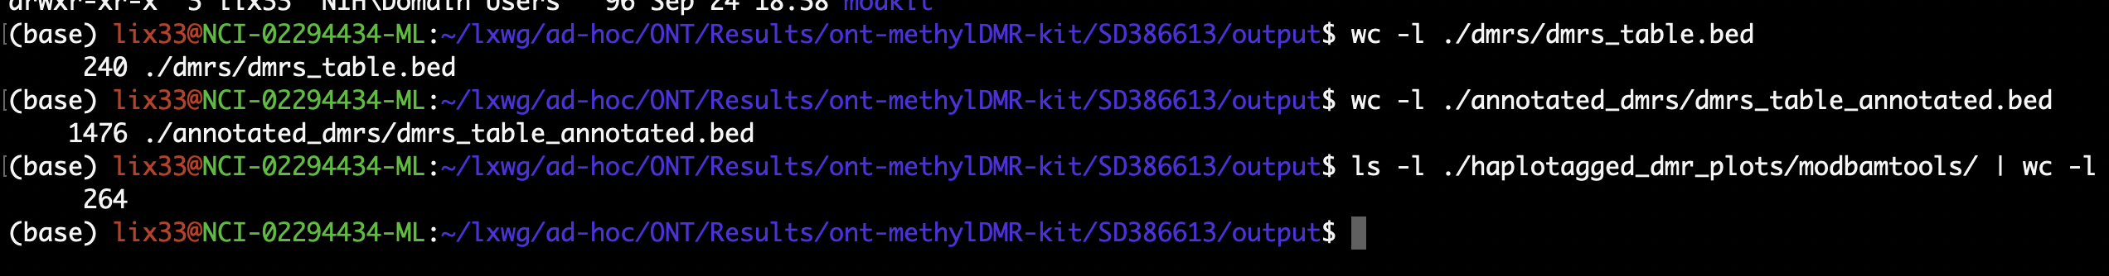
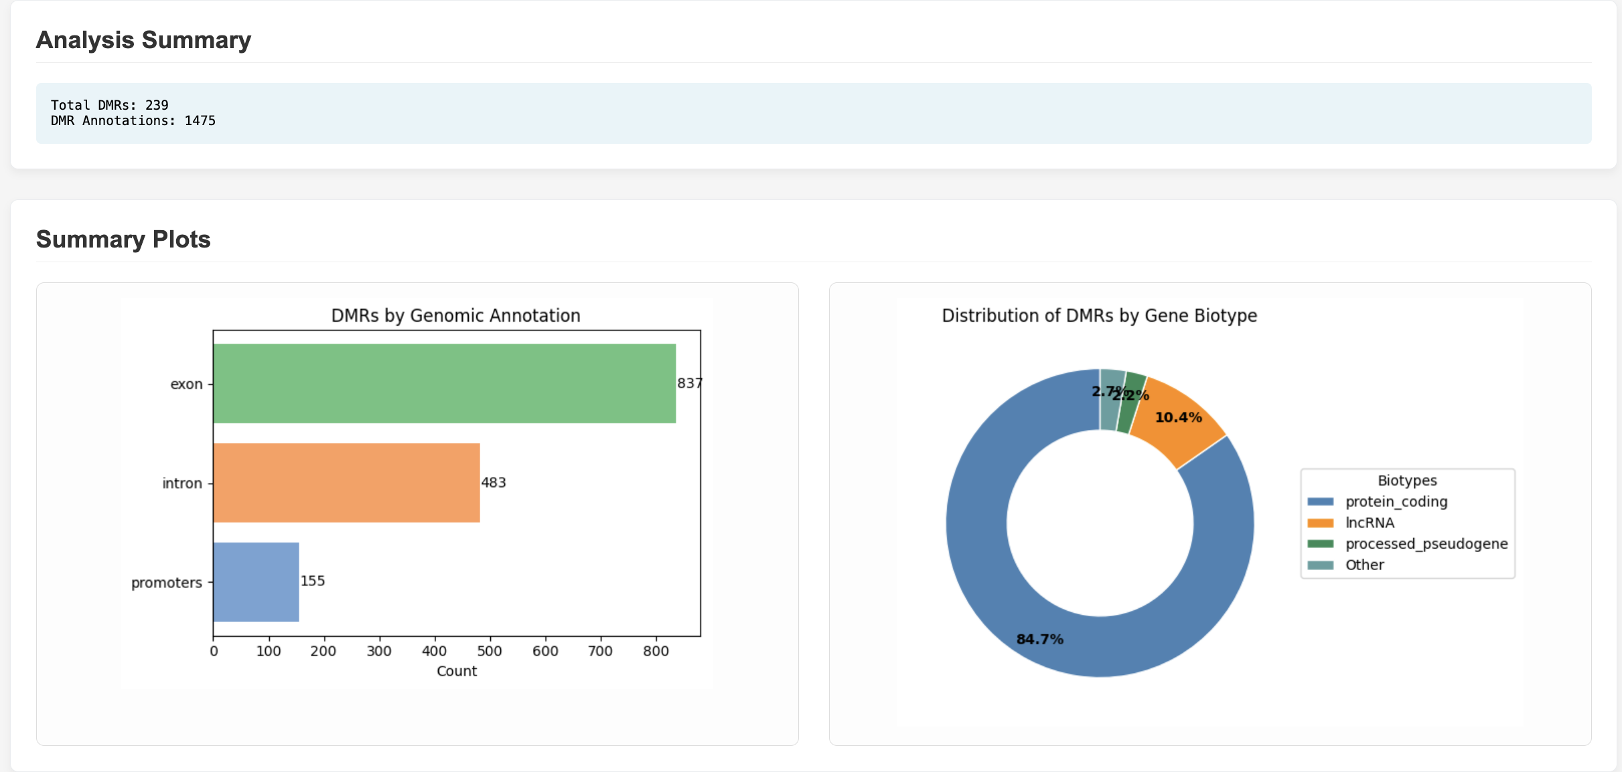
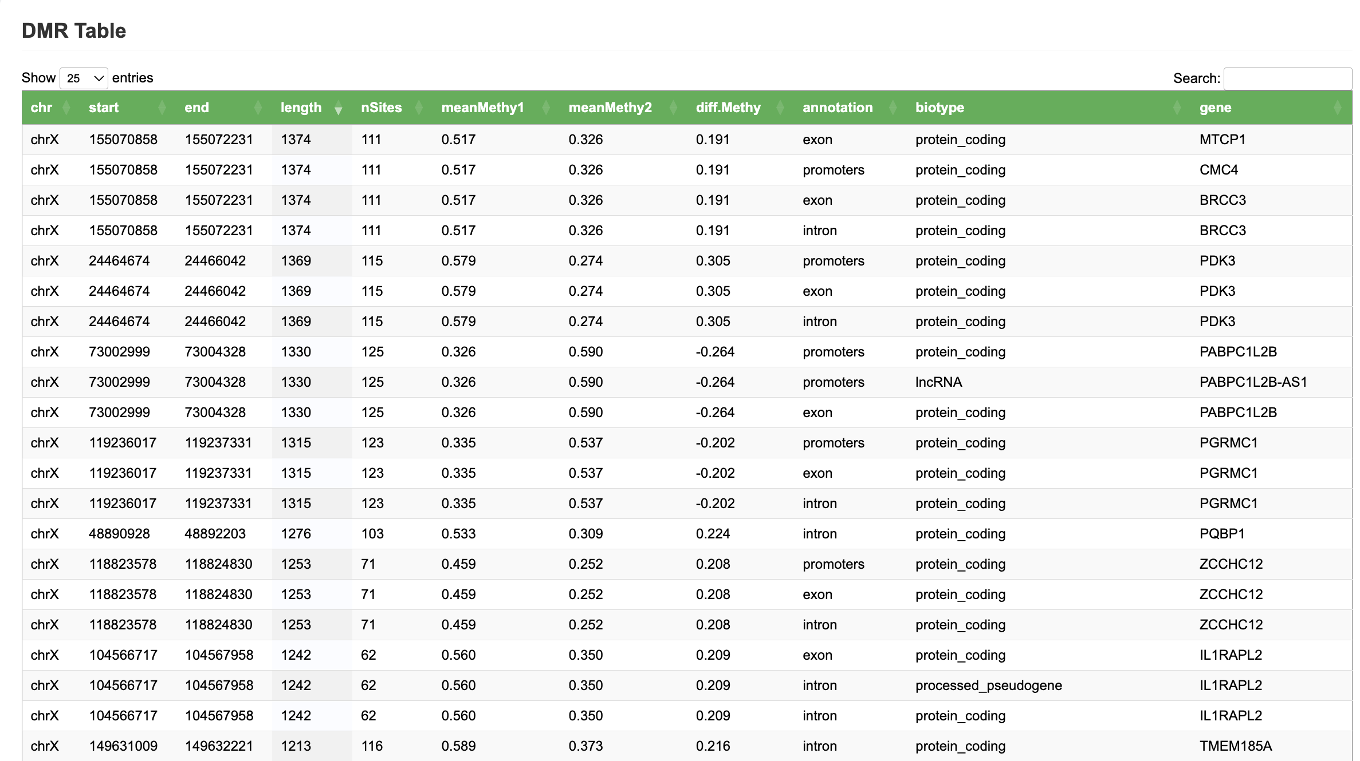
Statistical Report（ont-methylDMR-kit）
Statistic Info
dmrs_table.bed: 239
dmrs_table_annotated.bed: 1475
The number of annotated dmr plot: 259
Number of entries in DMR Table (report): 586
Report (Differentially Methylated Regions (DMRs) Summary)
https://github.com/NCI-CGR/ONT_Analysis_Xin_Share_Pubic/blob/main/Analysis/Methylation/CustomizedScript/Visualizaton.md#ModBamTools

Slide 18
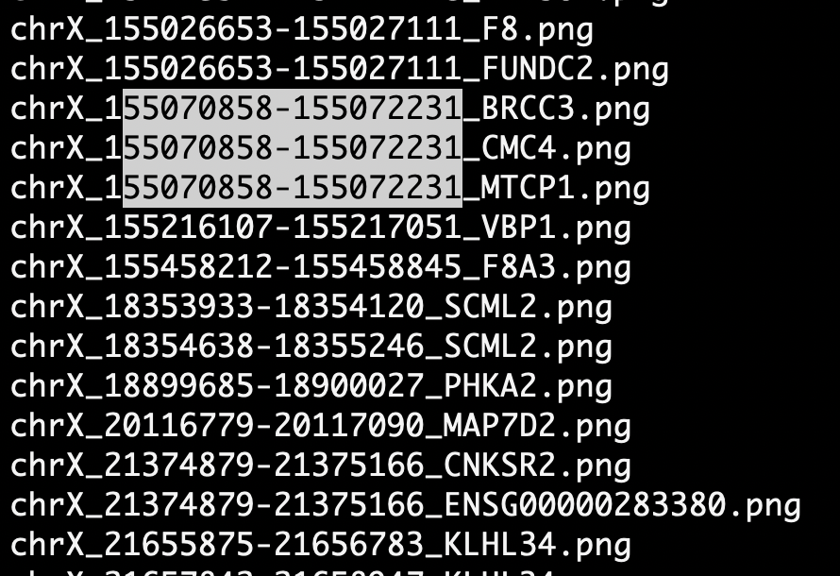
modbamtools
Explanation
dmrs_table.bed: 239
contains the high-confidence DMRs that pass all filters (e.g., p-value threshold, coverage, effect size, etc.).
It is usually the final output used for downstream analysis and visualization.
dmrs_table_annotated.bed: 1475
The number of overlaps between DMRs and annotated features (GTF File)
Number of entries in DMR Table (report): 586
Annotated DMR, 1 DMR x Multiple Gene annotation x multiple different type of region
The number of annotated dmr plot: 259
Multiple feature annotations per DMR
If DMR overlaps several feature types (e.g., “exon” and “promoter”), the tool may create one annotation per feature.

